Slide 1
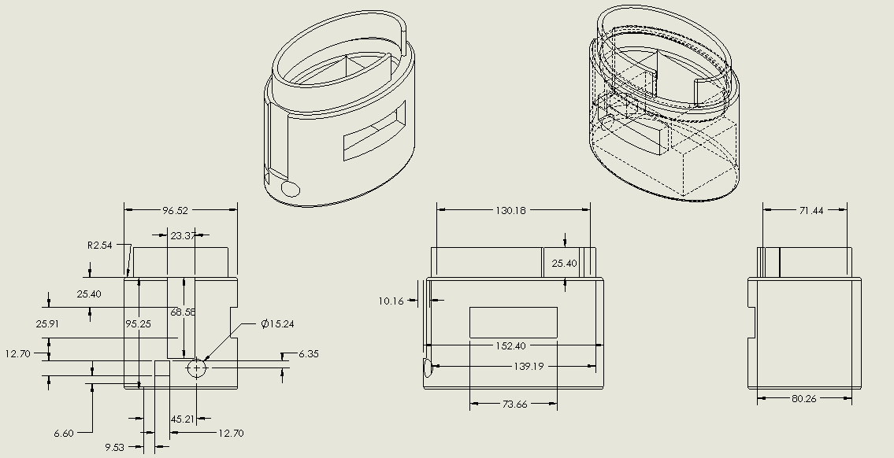
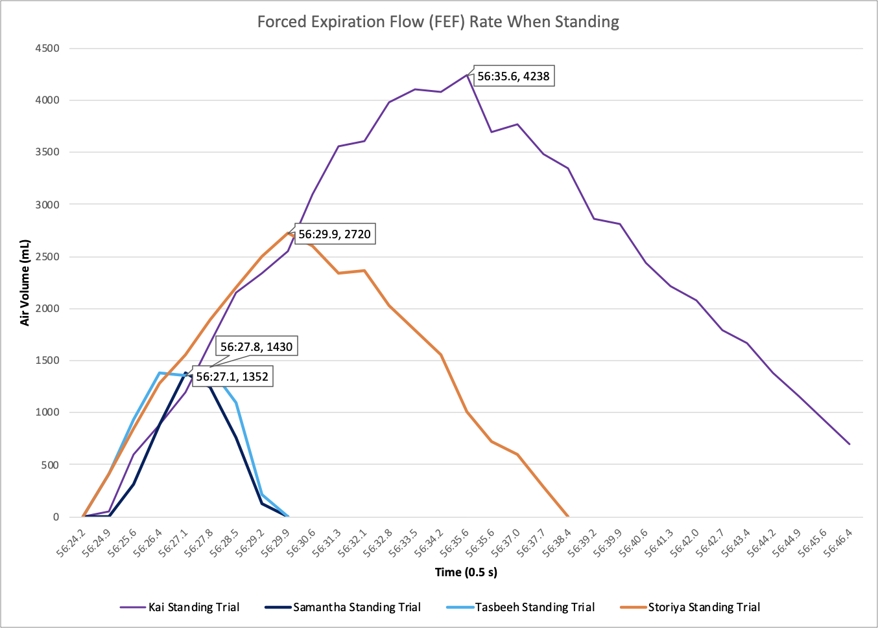
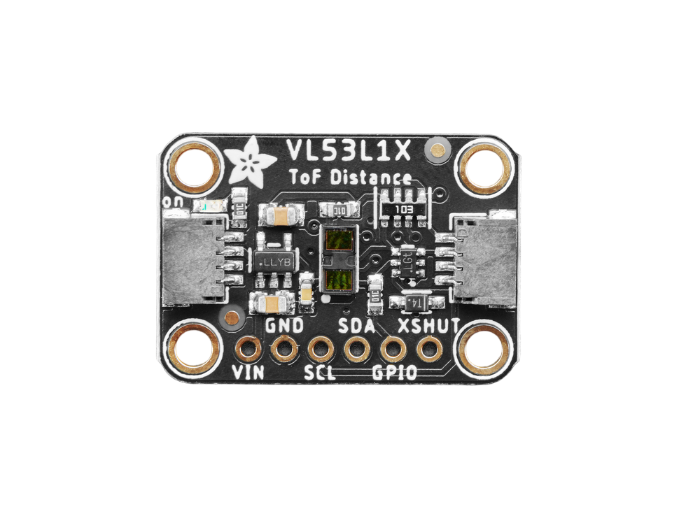
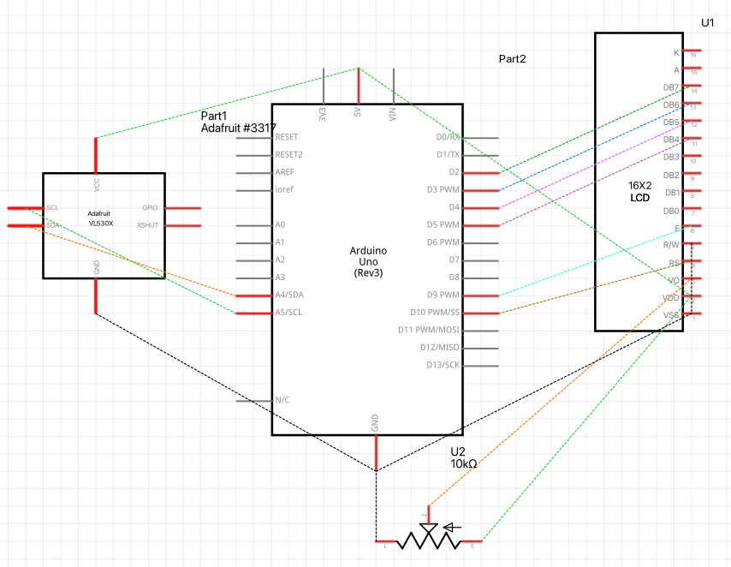
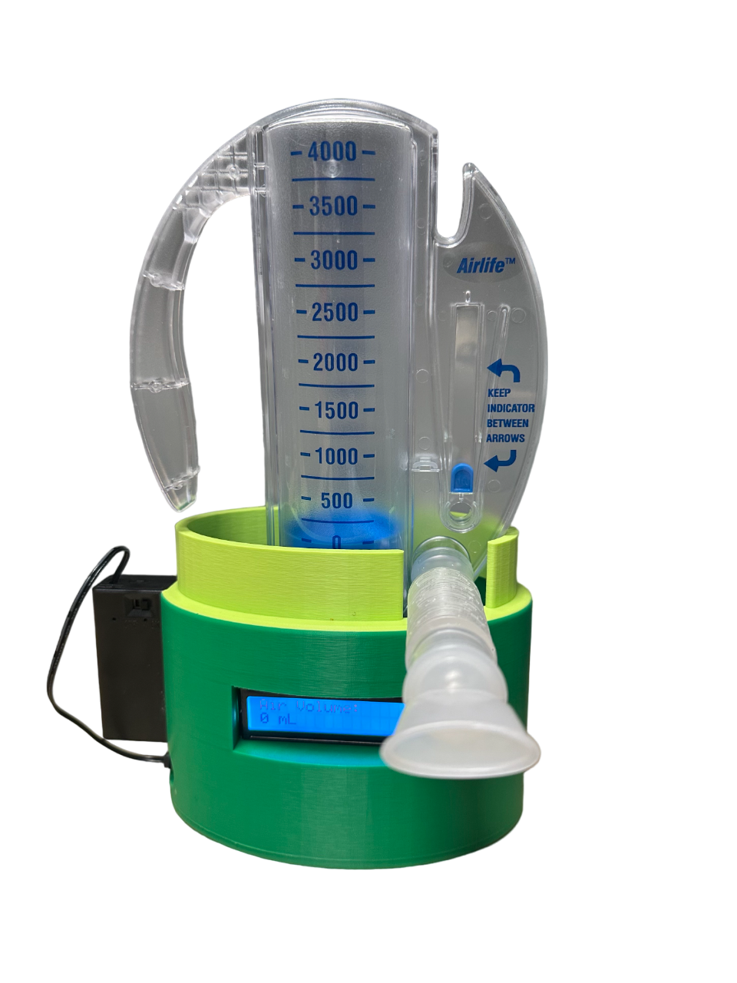
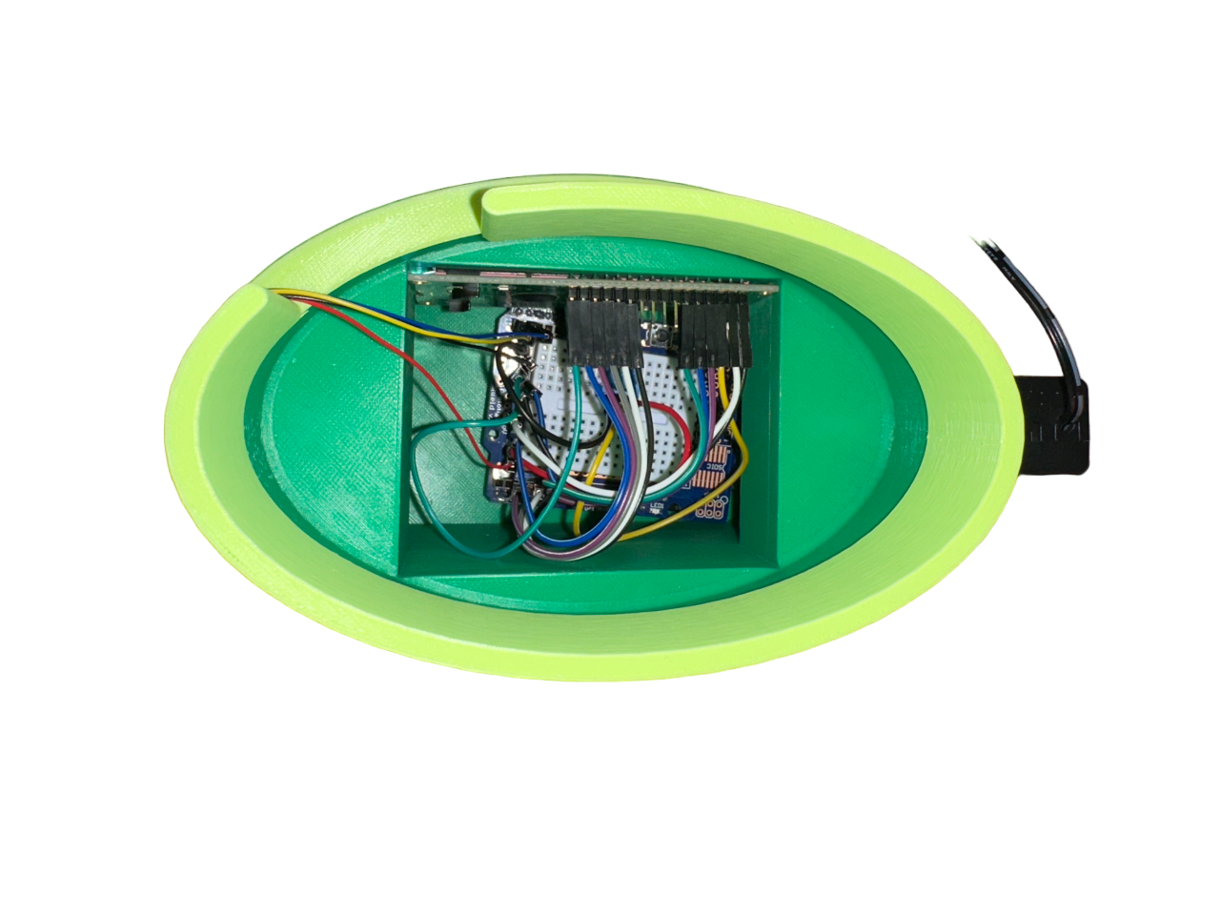
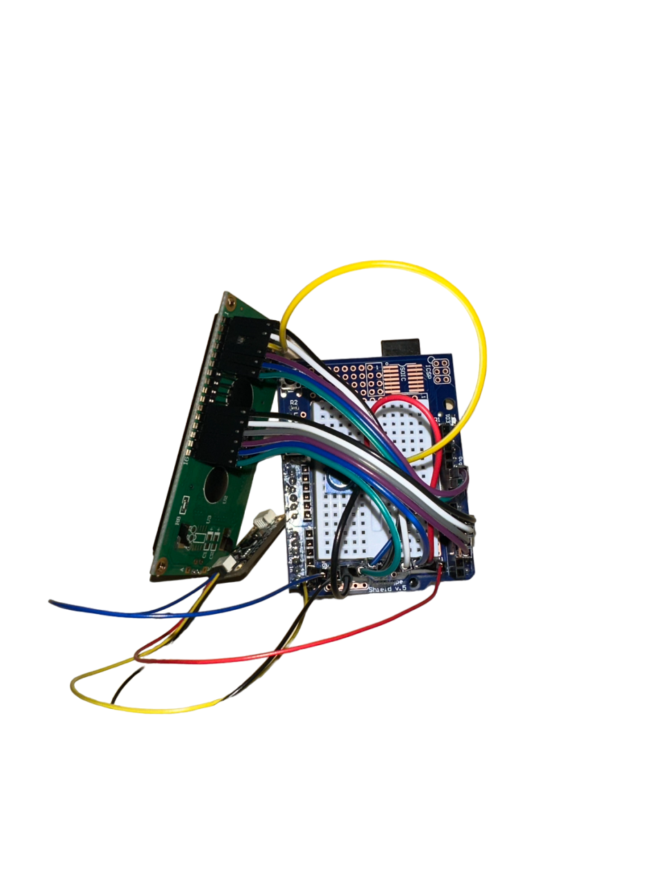
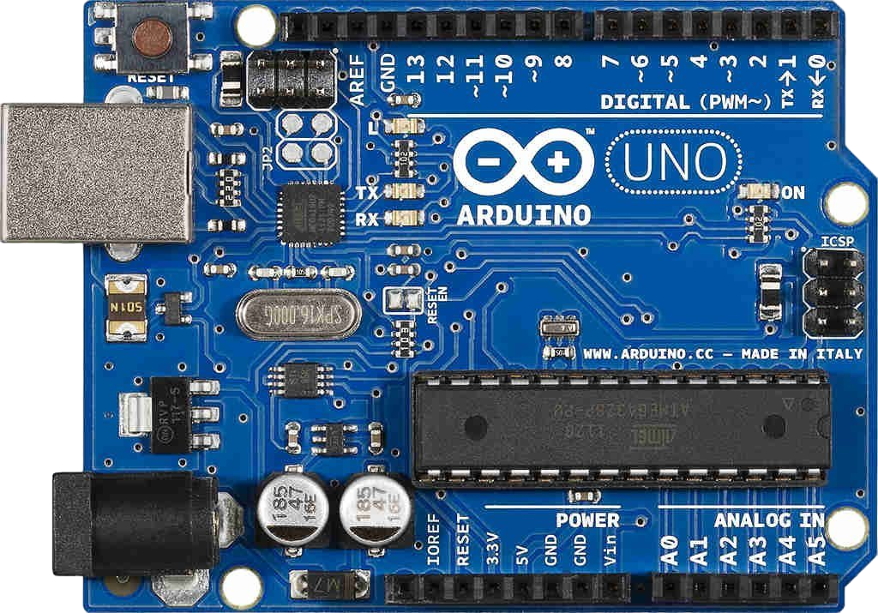
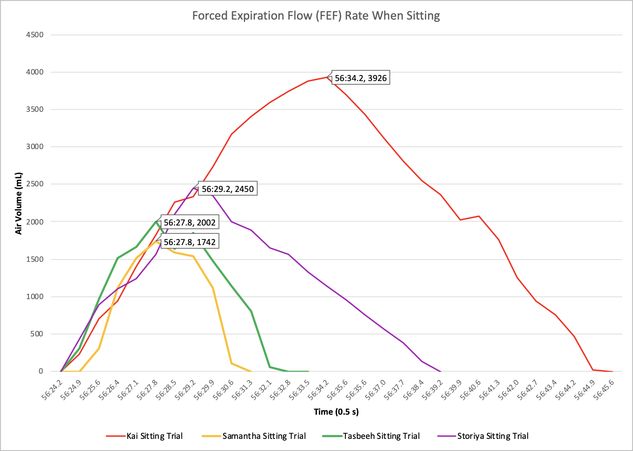
Intelligent Incentive Spirometer
Storiya I, Kai K, Tasbeeh M, Samantha Z
Sponsors: Gene Yang MD, William Kelly MD, Brian Quaranto MD
Project Advisors: Ciprian N Ionita PhD, Aditya Ashok Bhosale
Introduction
The Intelligent Incentive Spirometer aims to solve the problems and limitations of the current incentive spirometer model.
The device is tailored towards patients suffering from post-operative pulmonary complications and rib fractures. It is used to diagnose pulmonary disease, measure inhalation/exhalation and improve overall lung health.
Methods
The battery powers the Arduino which controls all the other mechanical components. The sensor is placed at the bottom of the spirometer to measure the distance of the moving piston. In return, it quantifies inhalation by displaying peak volumes through the LCD.
Time of Flight Sensor VL53L1X
Time of Flight sensor VL53L1X uses a tiny invisible laser source that measures how long the light takes to travel and bounce back to the sensor to calculate the distance in millimeters.
We converted the distance from millimeters to milliliters in volume.
Arduino Uno R3
High performance, 8-bit microcontroller that consists of a power jack and a USB connection port to transfer or visually view data of spirometry volumes.
Programming through Arduino IDE open source software that runs code through C++ programming language.
Our device will combat all of the technological gaps in the current incentive model while still maintaining a level of rehabilitation that will reduce postoperative pulmonary complications in patients.
Fig.1. CAD Drawings and Dimensions (mm) of Housing Unit
Fig. 4. Time of Flight Sensor Data during Standing Trial
Conclusion
The Intelligent Incentive Spirometer will help to increase overall usage and aim to appeal to all populations. Our device, is guaranteed to measure accurate peak volumes through consistent inhalation and expiration by quantifying the value through our display screen. As pulmonary complications arise, we hope to bring feasibility, patient compliance, and overall lung function progression.
Fig. 2. Schematic of components in Housing Unit
Results
Future Work
Bluetooth Connection/App for Data transfer
SD Card for Data Logger within the device
More Incentives: Buzzer/Alarm
Materials
Arduino Uno R3
Arduino Uno R3 Prototyping shield
16X2 LCD display
VL53L1X Time of flight distance sensor
Female-Male/Male-Male wires
Potentiometer
9V battery holder/9V battery
PLA 3D printed housing unit
References
Arduino. (2021). Arduino Uno REV3. Arduino Online Shop. Retrieved May 1, 2023, from https://store-usa.arduino.cc/products/arduino-uno-rev3/?gclid=CjwKCAjwxr2iBhBJEiwAdXECw_zC_4uFGzYWzItNkrJRqx5WwmOvOVdr_OolFxangMfm3WOGFORqjhoC9JoQAvD_BwE
Rembor, K. (2021, October 27). Adafruit VL53L1X time of Flight Distance Sensor. Adafruit Learning System. Retrieved May 1, 2023, from https://learn.adafruit.com/adafruit-vl53l1x/overview
Fig. 3. Time of Flight Sensor Data during Sitting Trial
Department of Biomedical Engineering
School of Engineering and Applied Sciences, University at Buffalo

